Slide 1
CASE STUDY Finding a new HQ location for ACME & CO.
By David C.

Slide 2
CASE STUDY: Finding a new HQ location for ACME & CO.
Challenge
A corporation - ACME & CO. - needs to move to a newer and larger office building to cope with its fast growing number of employees.
The business is currently located in Chelsea, a neighborhood of the New York City, NY,'s borough of Manhattan.
The company's Board of Directors agreed to move to a larger and newer office building in the current City borough of Manhattan, NY.
The ACME & CO. executive team asked the data science / business analysis department (DS&BA dept.) to identify Manhattan, NY,'s neighborhoods similar to Chelsea - in terms of type of facilities, infrastructure, recreational areas and businesses.
Solution
After a segmentation and clustering analysis of the New York City, NY,'s boroughs and neighborhoods, the company's DS&BA dept. finally identified that Chelsea belongs to the city's neighborhoods cluster number 7. This cluster includes the following similar neighborhoods: Greenwich Village, Soho, West Village, Little Italy, and Chinatown. The company's procurement department can now start engaging with commercial real estate agencies to find the best office buildings located in the identified neighborhoods.

Slide 3
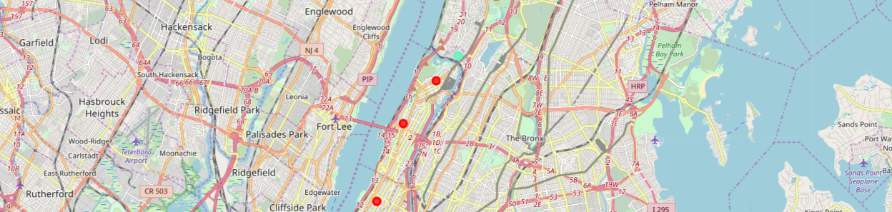
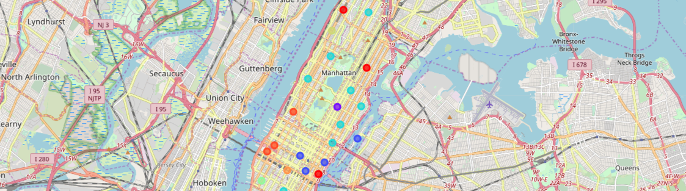
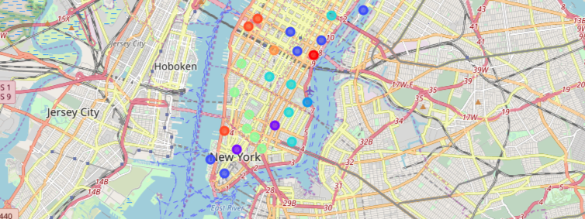
Manhattan, NY,'s neighborhoods similar to Chelsea
Chelsea belongs to the city's neighborhoods cluster number 7. This cluster includes the following similar neighborhoods: Greenwich Village, Soho, West Village, Little Italy, and Chinatown.
Neighborhoods similar to Chelsea: Greenwich Village, Soho, West Village, Little Italy, and Chinatown.

Slide 4
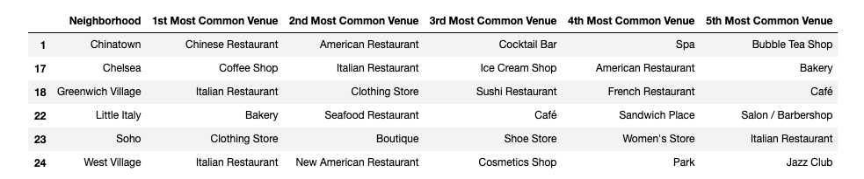
Manhattan, NY,'s neighborhoods similar to Chelsea
Chelsea belongs to the city's neighborhoods cluster number 7. This cluster includes the following similar neighborhoods: Greenwich Village, Soho, West Village, Little Italy, and Chinatown.
The company's procurement department can now start engaging with commercial real estate agencies to find the best office buildings located in the identified neighborhoods.

